Slide 1
Newton’s Second Law

Slide 2
By the end of the lesson, you should be able to:
Explain Newton's Second Law.
Recall the formula for Newton's Second Law.
Use Newton's Second Law to calculate mass and acceleration.

Slide 3
Newton's Second Law says that an object will accelerate in the direction of an unbalanced force acting on it.
The size of the acceleration depends on the object's mass and the size of the net force acting on it.

Slide 4
We can write Newton's Second Law as:
F_{net​}=m×a
Fnet​ is the net force acting on the object, measured in newtons (N).
The mass of the object is represented by m and it is measured in kilograms (kg).
Finally, a represents the acceleration of the object, measured in meters per second squared (m/s²).

Slide 5
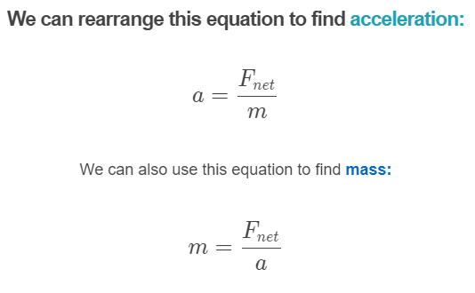

Slide 6
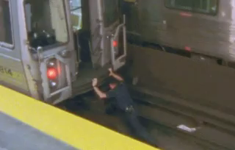
According to Newton's Second Law, we need to apply a larger force to accelerate a heavier object.
You probably knew this - you didn't need Newton to tell you that it's harder to push heavy objects than light ones!

Slide 7
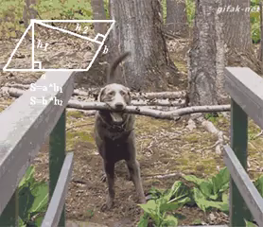
Using Newton's Second Law, we can find unknown masses, accelerations and net forces of objects.
We just need to know two of the three variables in the equation.
To do this, we rearrange the equation for the required variable and substitute in the known values.
We will replace the F_{net}​ in this equation with an F to simplify it.
F=m×a

Slide 8
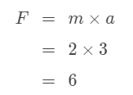
Let's say we know the mass and acceleration of an object and want to find the net force acting on it.
We can simply substitute these numbers into the equation without rearranging it.
For example, if an object with mass 2 kg has an acceleration of 3 m/s², we substitute these values in to find the net force:
Therefore, there is a net force of 6 N acting on this object.

